Slide 1
Unit 2 – Search Strategies
SEARCH STRATEGIES (12)
Breadth-First Search
Uniform Cost Search
Depth-First Search
Depth-Limited Search
Iterative Deepening Search
Bidirectional Search
Heuristic Search Techniques
A* Search
AO* Algorithm
Adversarial Search:
Minimax Algorithm
Alpha beta Pruning

Slide 2
Problem solving by searching
Problem solving agent
Atomic representations
no internal structure visible to the problem solving algorithms
Planning agents
Goal based agents
use more advanced factored or structured representations
Search algorithms
Uninformed: only problem definition. No other information. Usually inefficient
Informed: given some guidance about solution, usually better than uninformed
Task environment assumption (simplest yet useful) : Solution to a problem is always a fixed sequence of actions

Slide 3
Goal Formulation
Goal
a set of environment/world states where goal is satisfied
Goal formulation
First step in problem solving
Based on the current situation and the agent's performance measure
What are the goals?
Goals help organize behaviour
by limiting objectives that the agent is trying to achieve
and hence limits the actions it needs to consider

Slide 4
Problem formulation
Question: What actions to perform to reach a goal state?
First, need to decide what actions and states need to be considered!
Problem formulation
Process of deciding what actions and states to consider, given a goal
Can agent with several immediate options of unknown value (relation to goal state) decide what to do ?
Yes, by first examining future actions that eventually lead to states of known value
Assumptions: Observable, Discrete, Known and Deterministic

Slide 5
Problem formulation assumptions
Properties of Task Environments for Problem Solving Agent
Observable
Agent always knows the current state
Discrete
Any given state there are only finitely many actions to choose from
Known
agent knows which states are reached by each action
Deterministic
each action has exactly one outcome
Under these assumptions, the solution to any problem is a fixed sequence of actions
So can be solved by a search approach

Slide 6
Search algorithms
Search
The process of looking for a sequence of actions that reaches the goal
Takes a problem as input and returns a solution in the form of an action sequence
Formulate a goal
Formulate a problem to solve
Call a search procedure to solve the problem(s)
If a solution is found, it is used to guide actions in execution phase
Agent removes first step from the sequence
Usually after performing the first action of the sequence
The agent will formulate a new goal
Once the solution has been executed
Design of Search algorithms
1. Formulate
2. Search
3. Execute

Slide 7
Simple Problem Solving Agent
function SIMPLE-PROBLEM-SOLVING-AGENT(percept) returns an action
persistent seq, an action sequence, initially empty
state, some description of the current world state
goal, a goal, initially null
problem, a problem formulation
state UPDATE-STATE(state, percept)
if seq is empty then
goal <- FORMULATE-GOAL(state)
problem <— FORMULATE-PROBLEM( state, goal)
seq <- SEARCH(problem)
if seq = failure then return a null action
action <— FIRST(seq)
seq <— REST(seq)
return action
Formulates a goal and a problem
Searches for a sequence of actions that would solve the problem,
Executes the actions one at a time
When this is complete, agent formulates another goal and starts over
Open loop system as agent ignores percepts when selecting an action in solution sequence
Ignoring the percepts breaking the loop between agent and environment

Slide 8
Five components of problem definition
Initial state: State agent starts in (Initial state)
Description of the possible Actions available
given a particular state s,
ACTIONS (s) - returns the set of actions that can be executed in s
Each of these actions is APPLICABLE in s
Transition Model
A description of what each action does specified by a function Result(s, a) that returns the state that results from doing action a in state s
Successor
Refers to any state reachable from a given state by a single action.

Slide 9
Five components of problem definition (2)
Goal state:
Determines whether a given state is a goal state
Either explicit set of possible goal states or
specified by an abstract property (checkmate in Chess)
Path Cost
Assigns a numeric cost to each path
Agent chooses a cost function that reflects its own performance measure
Simplifying assumptions
cost of a path can be described as the sum of the costs of the individual actions along the path
Nonnegative costs
Usually the five components are gathered into a single data structure

Slide 10
State-space and other definitions
Solution: action sequence from initial state to goal state
Solution quality: measured by the path cost function
Optimal solution: has the lowest path cost among all solutions
The initial state, actions, goal state and transition model implicitly define the state space of the problem together
The set of all states reachable from the initial state by any sequence of actions
The state space forms a directed network or graph
in which the nodes are states and the links between nodes are actions.
A path in the state space
a sequence of states connected by a sequence of actions
Step cost of taking action a in state s to reach state s’ = e(s,a,s')

Slide 11
Problem types
Toy problem
Intended to illustrate /exercise various problem solving methods
Can be given a concise, exact description
Hence performances of algorithms can be compared
Real-world problem
one whose solutions people actually care about
Such problems tend not to have a single agreed-upon description
We can give the general flavour of their formulations.

Slide 12
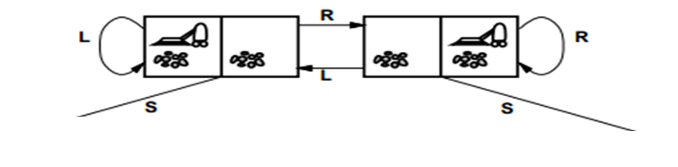
Abstraction

Slide 13
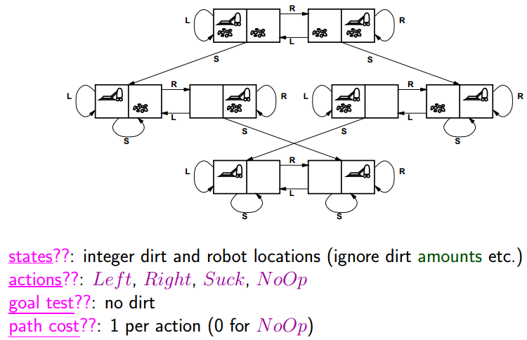
Abstraction

Slide 14
Toy Problem Example: Vacuum World
Take 5 minutes to write down the following for the vacuum world toy problem
States
Initial state:
Actions:
Transition model:
Goal test:
Path cost:

Slide 15
Toy Problem Example: Vacuum World
States
State is determined by both the agent location and the dirt locations
The agent is in one of two locations, each of which might or might not contain dirt
There are 2 x 2² = 8 possible world states
A larger environment with n locations has n2^{n} states.
Initial state: Any state can be designated as the initial state
Actions: Each state has just three actions: Left, Right, and Suck
Larger environments might also include Up and Down
Transition model
The actions have their expected effects, except that
moving Left in the leftmost square,
moving Right in the rightmost square, and
Sucking in a clean square have no effect.
Goal test: This checks whether all the squares are clean.
Path cost: Each step costs 1, so the path cost is the number of steps in the path.

Slide 16
Abstraction

Slide 17
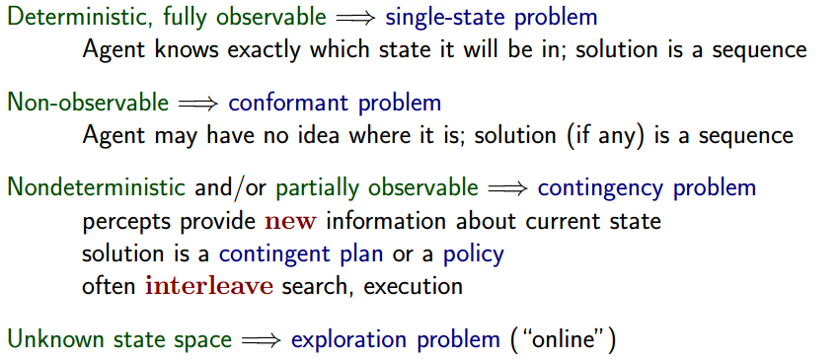
Problem Types

Slide 18
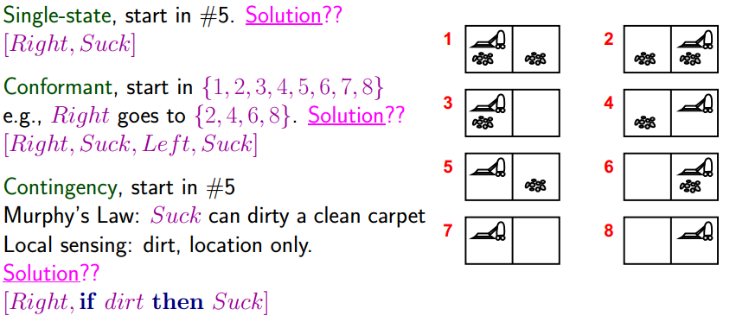
Example: Vacuum world

Slide 19
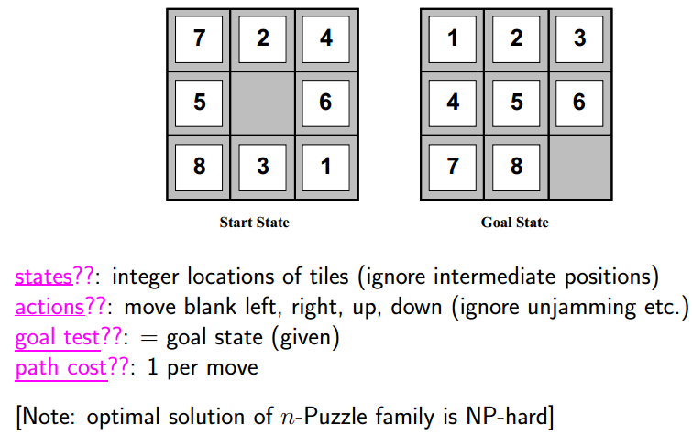
Example: 8 puzzle
For the 8 piece puzzle above define
States, Actions, Goal Test and Path Cost

Slide 20
Example: 8 puzzle

Slide 21
8-Queens problem
Goal
To place eight queens on a chessboard such that no queen attacks any other
An incremental formulation
involves operators that augment the state description, starting with an empty state
Each action adds a queen to the state.
A complete-state formulation
starts with all 8 queens on the board and moves them around
For the 8 queens problem define States, Actions, Transition model, Goal Test and Path Cost

Slide 22
8-Queens problem: Incremental
States: Any arrangement of 0 to 8 queens on the board
Initial state: No queens on the board
Actions: Add a queen to any empty square
Transition model: Returns the board with a queen added to the specified square
Goal test: 8 queens are on the board, none attacked
A better formulation would prohibit placing a queen in any square that is already attacked:
States: All possible arrangements of n queens (0 <= n <= 8), one per column in the leftmost n columns, with no queen attacking another
Actions: Add a queen to any square in the left most empty column such that it is not attacked by any other queen

Slide 23
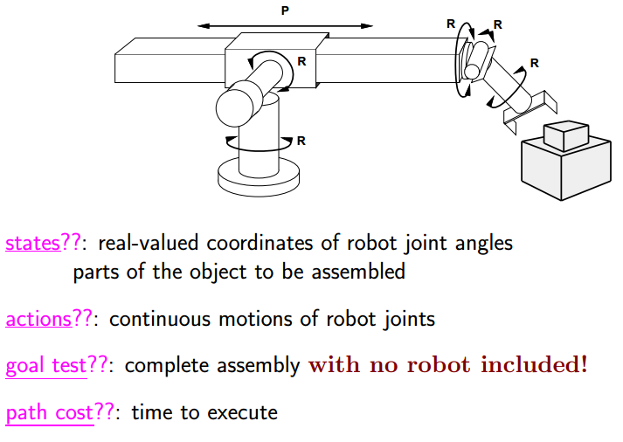
Real world problem : Robotic assembly

Slide 24
Assignments
Home work problems are assignments – CO Based
Due date: One week from announcement
CO1:Apply the fundamental AI concepts to represent and solve real-world problems
1-1. Self study – 1.3.6 – 1.3.10 – 1 page summary
1-2. Self study 1.5 – Summary – ½ page summary
1-3. AIMA book Chapter 1 : 1.10 – 1.14
1-4. AIMA book Chapter 2: 2.3, 2.4, 2.5, 2.6, 2.7, 2.9
1-5. Next page

Slide 25
Assignments
1-5
For the following problems suggest representation of environments with justification. The goal is to optimize both effectiveness and efficiency
Designing a Massively Multiplayer online Role Playing Game (MMORPG) where different entities are to be represented by AI models
Design a Natural Language Understanding module to recognize satire or parody elements in a Tamil story
Dataset with climate information with 20 different parameters and the task is to predict if there would be a hurricane in the next few days

Slide 26
Search approaches

Slide 27
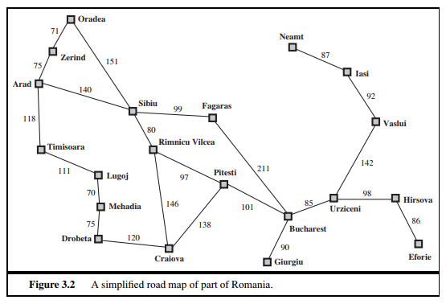
Example problem
Agent is Arad - Needs to fly out of Bucharest – Find the shortest path

Slide 28
Infrastructure for search algorithms
Search algorithms require a data structure to keep track of the search tree that is being constructed
For each node n of the tree, the structure contains four components:
n.STATE: the state in the state space to which the node corresponds;
n.PARENT: the node in the search tree that generated this node;
n.ACTION: the action that was applied to the parent to generate the node;
n.PATH-COST: the cost, traditionally denoted by g(n), of the path from the initial state to the node, as indicated by the parent pointers.

Slide 29
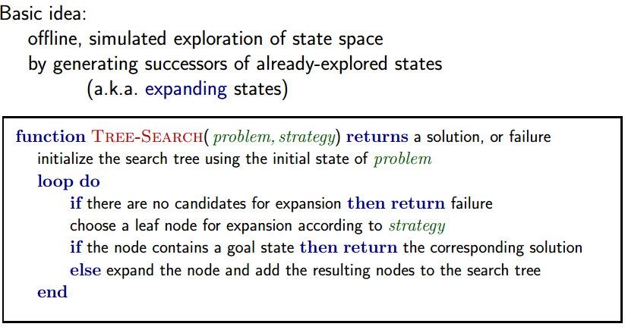
Tree Search
Solution is an action sequence
Search algorithms work by considering various possible action sequences
Possible action sequences starting at the initial state form a search tree
with the initial state at the root
Expanding the current state (Frontier – leaf nodes available for expansion)
Generating a new set of states
Exploring the new states

Slide 30
Tree Search
Search algorithms all share this basic structure
Vary primarily on how they choose which state to expand next - called search strategy

Slide 31
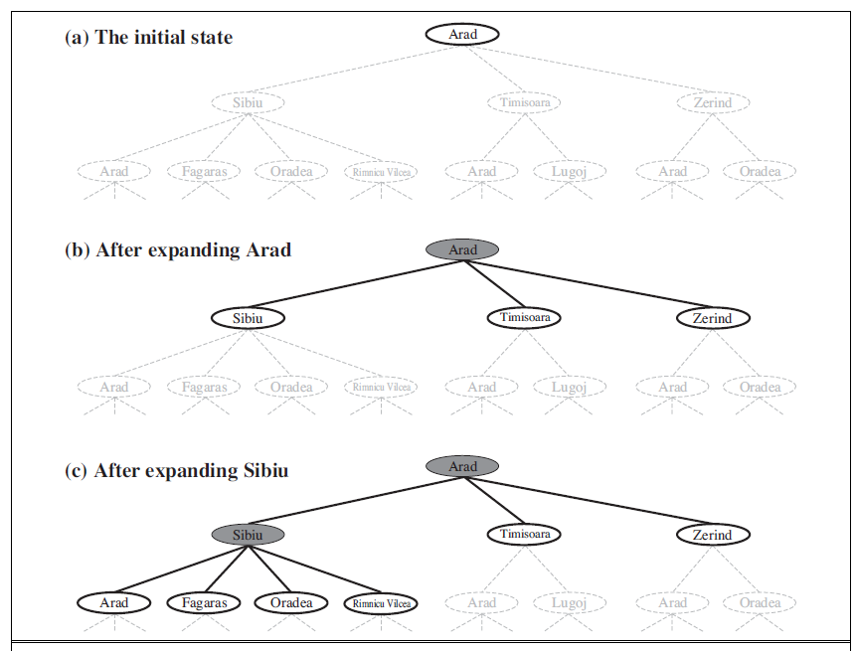
Tree search example
Partial search trees for finding a route from Arad to Bucharest
Expanded Nodes are shaded
Generated but not yet expanded nodes are outlined in bold
Not yet generated nodes in faint dashed lines

Slide 32
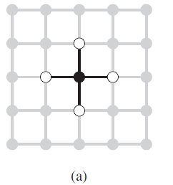
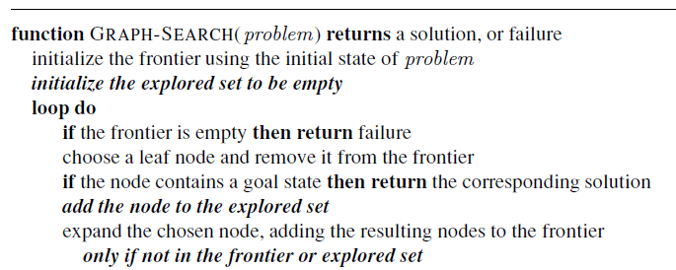
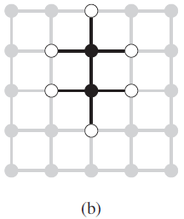
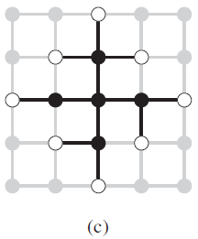
Graph Search
Bold italic in GRAPH-SEARCH are additions needed to handle repeated states
Redundant paths are unavoidable
algorithms that forget their history are doomed to repeat it
avoid exploring redundant paths is to remember where one has been

Slide 33
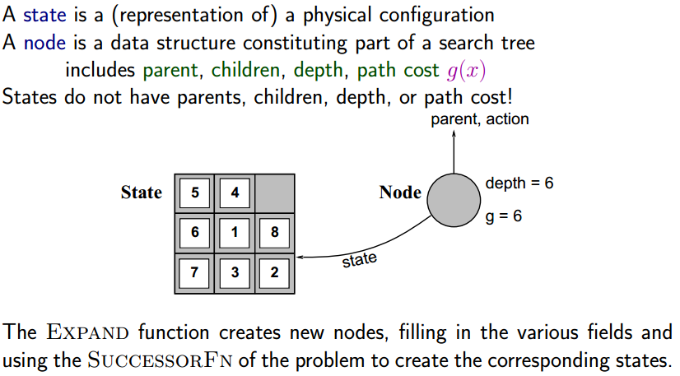
Implementation: States vs. Nodes

Slide 34
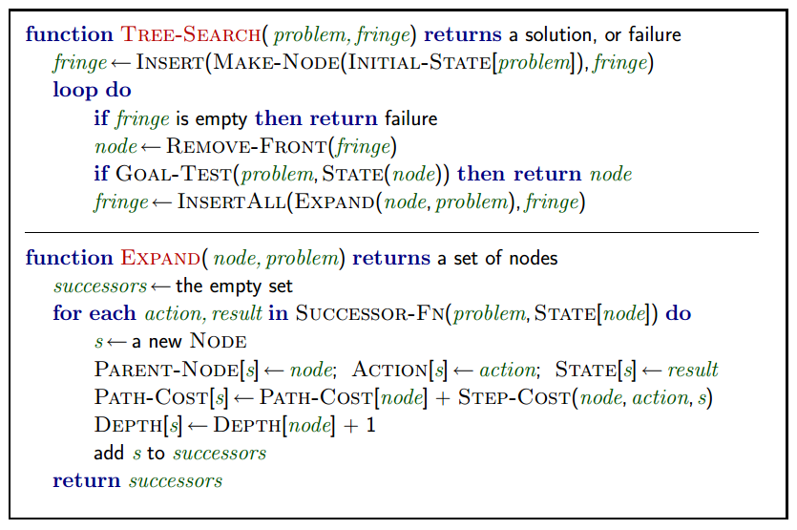
Tree Search: Implementation

Slide 35
Search Types
Uninformed (blind) search
Strategies have no additional information about states beyond the problem definition
Can generate successors
Can distinguish a goal state from a non-goal state
Strategies distinguished by the order in which nodes are expanded
Breadth-First search
Uniform-cost search
Depth-first search
Depth-limited search
Iterative deepening search
Informed search / heuristic search
Strategies know whether one non-goal state is "more promising" than another

Slide 36
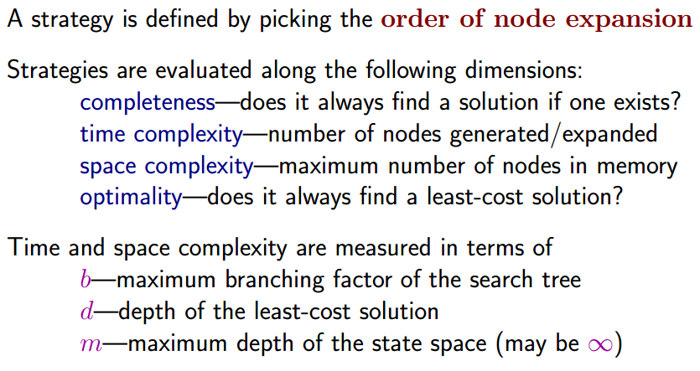
Search Strategies

Slide 37
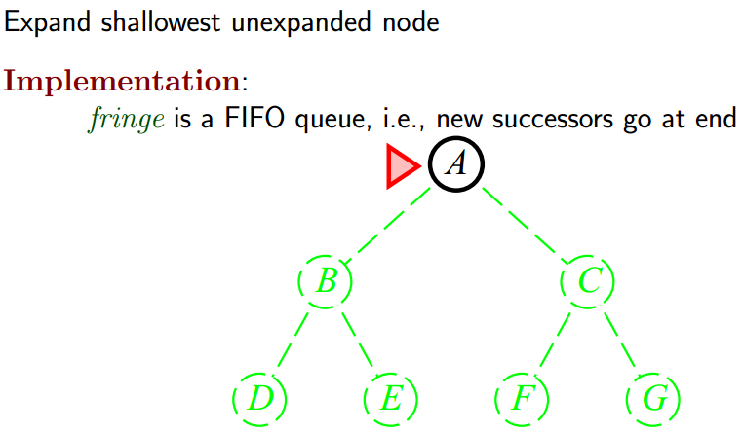
Breadth-First Search (BFS)

Slide 38
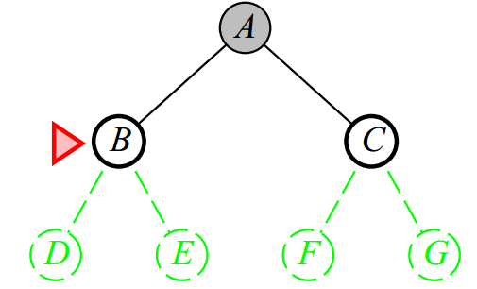
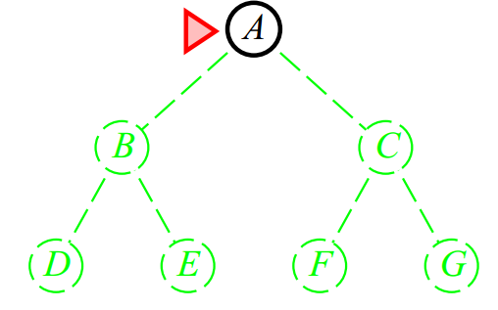
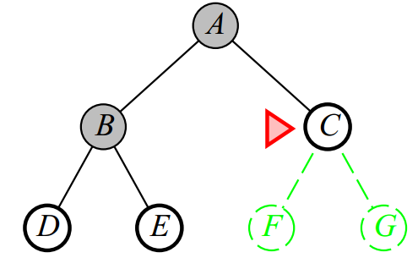
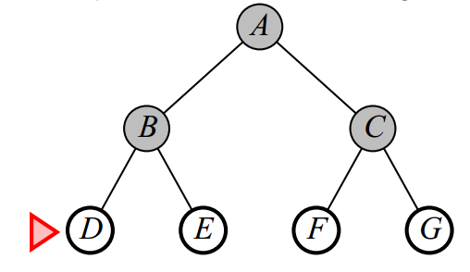
BFS – Contd.

Slide 39
Breadth-First Search Pseudo code
Inaction BREADTH-FIRST-SEARCH (problem) returns a solution, or failure
node <-- a node with STATE = problem.INITIAL-STATE, PATH-COST =0
if problem.GOAL-TEST(node.STATE) then return SOLUTION(node)
frontier <— a FIFO queue with node as the only element
explored <— an empty set
loop do
if Empty?(frontier) then return failure
node q <— POP(frontier) /* chooses the shallowest node in frontier */
add node.STATE to explored /* node should not be explored again*/
for each action in problem.ACTIONS(node.STATE) do /* possible children */
child <— CHILD-Node(problem, node, action) /*get the child*/
if child.STATE is not in explored or frontier then
if problem.GOAL-TEST(child.STATE) then return SOLUTION( child)
frontier.INSERT(child, frontier) /* not explored, add to frontier */

Slide 40
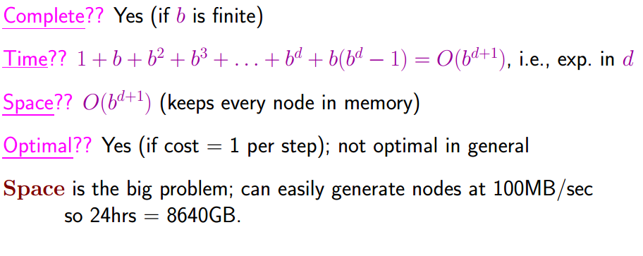
Breadth-First Search
Assuming that 1 million nodes can be created a second and 1000 bytes storage per node

Slide 41
Uniform-cost search
What if the costs are different?
Breadth-First becomes Uniform-cost search, if the lowest step cost is chosen for selecting a node for expansion
Differs from BFS
Goal test is applied when node is picked for expansion rather than creation
Better paths are looked for even after reaching goal state (at the lowest level – depth)
Not based on b/d. Based on Cost!
Assume each step costs at least ε

Slide 42
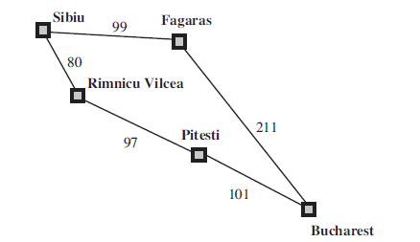
Uniform-cost search
Uniform-cost search expands nodes in order of their optimal path cost
Does not care about the number of steps a path has
Only about the total cost
Can get stuck in an infinite loop if there is a path with an infinite sequence of zero-cost actions
Book example: Successors of Sibiu are Rimnicu Vilcea and Fagaras, with costs 80 and 99, respectively
Least-cost node, Rimnicu Vilcea, is expanded next, adding Pitesti with cost 80 + 97=177
The least-cost node is now Fagaras, so it is expanded, adding Bucharest with cost 99+211=310
Now a goal node has been generated, but uniform-cost search keeps going,
Choosing Pitesti for expansion and adding a second path to Bucharest with cost 80+97+101= 278
Final chosen path:

Slide 43
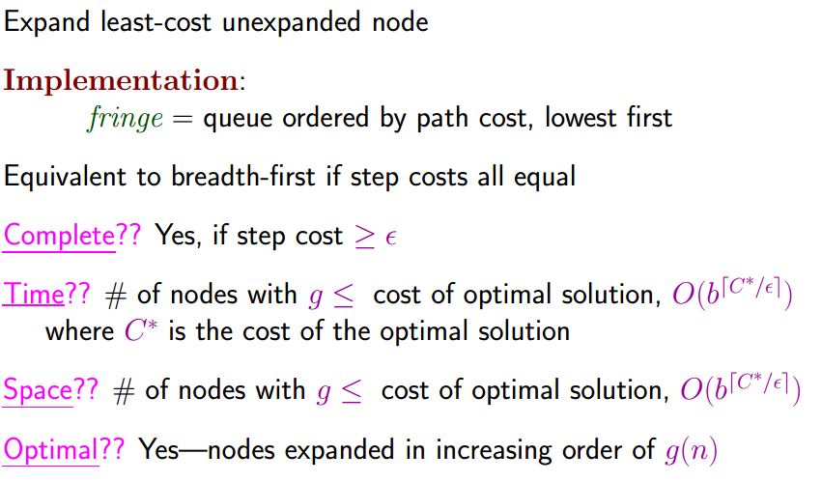
Uniform-cost Search

Slide 44
Depth-First Search (DFS)
Expands the deepest node in the current frontier of the search tree
Proceeds immediately to the deepest level of the search tree, where the nodes have no successors.
As nodes are expanded, they are dropped from the frontier, so then the search backs up to the next deepest node that still has unexplored successors
fringe =LIFO queue ,i.e., put successors at front

Slide 45
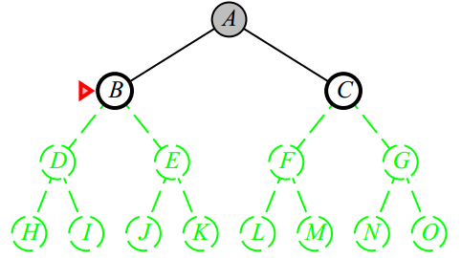
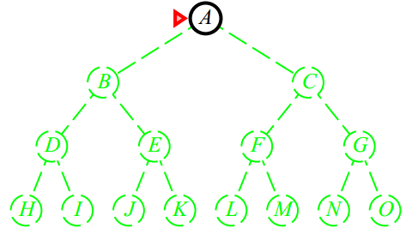
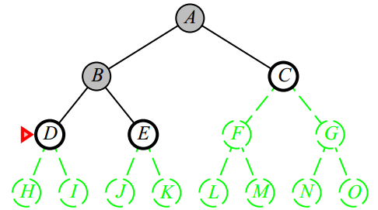
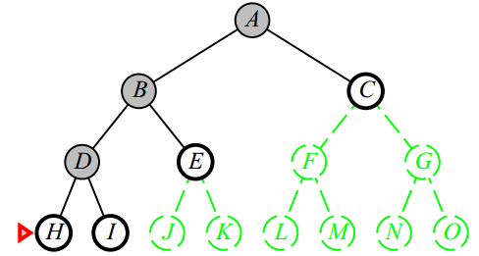
DFS-Contd.

Slide 46
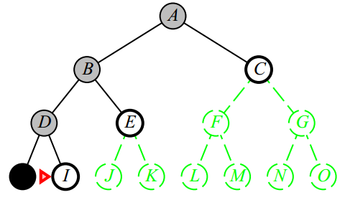
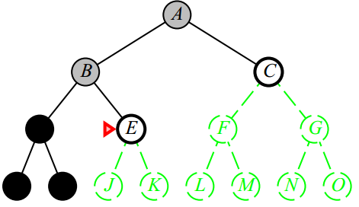
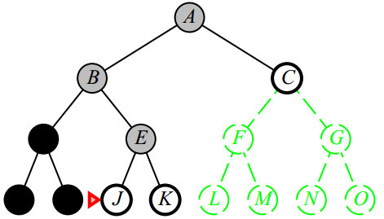
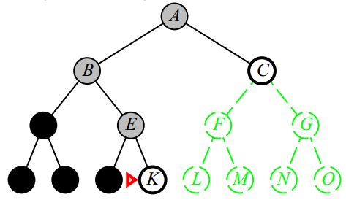
DFS-Contd.

Slide 47
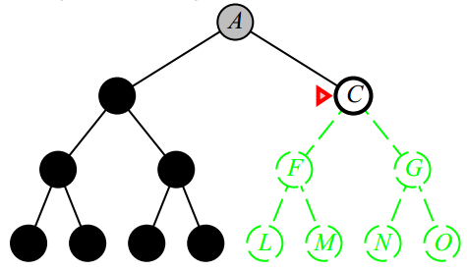
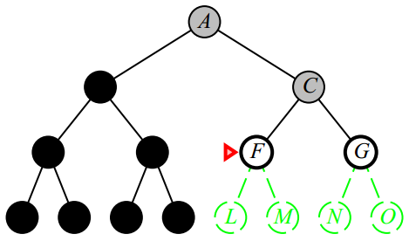
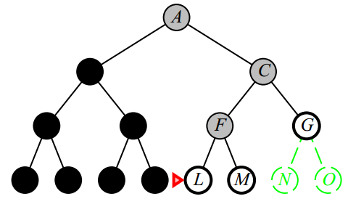
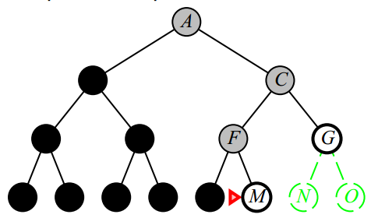
DFS-Contd.

Slide 48
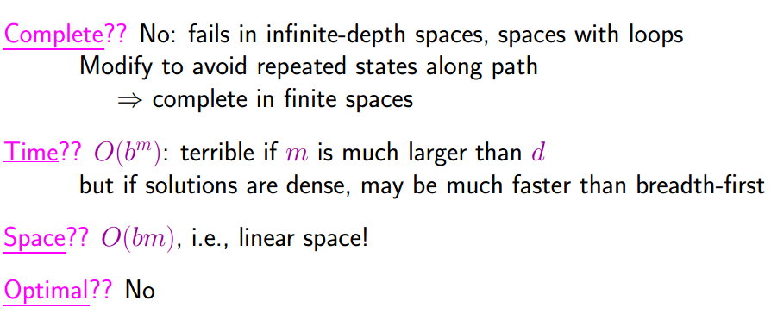
DFS - Properties
A variant of depth-first search is called backtracking search uses still less memory.
In backtracking, only one successor is generated at a time rather than all successors;
Each partially expanded node remembers which successor to generate next
only O(m) memory is needed rather than O(bm)

Slide 49
Depth-limited search
DFS failure in infinite spaces can be addressed by limiting depth
Depth limit l (hopefully l ≤ d, where d is the minimum depth at which the shallowest goal is available)
Depth-limited search will also be non-optimal if l >> d
Time complexity O(b^{l}), Space Complexity O(bl)
DFS is special case of DLS, with l = infinity
20 cities are in Romania map example
So |hops| to reach any node is ≤ n (so l could be set as 19)
However in this specific example, any city can be reached from any other city in at most 9 steps
So l = 9 is the best choice (9 is the diameter of state space)

Slide 50
Iterative deepening depth-first search
Combination of depth-first tree search, with finding the best depth limit
by gradually increasing the limit
first 0, then 1, then 2, and so on
until a goal is found
Goal is at depth limit d, the depth of the shallowest goal node
Iterative deepening combines the benefits of depth-first and breadth-first search
Modest memory requirements (O(bd)) as DFS
Like BFS, Complete when the branching factor is finite and
optimal when path cost is non-decreasing function of depth of node

Slide 51
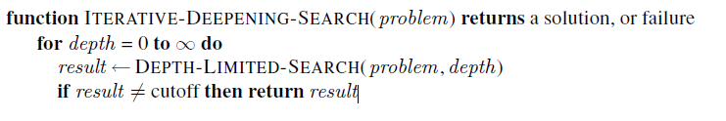
Iterative deepening depth-first search
Iterative deepening search algorithm
repeatedly applies depth limited search with increasing limits
terminates
when a solution is found or
if the depth limited search returns failure, meaning that no solution exists

Slide 52
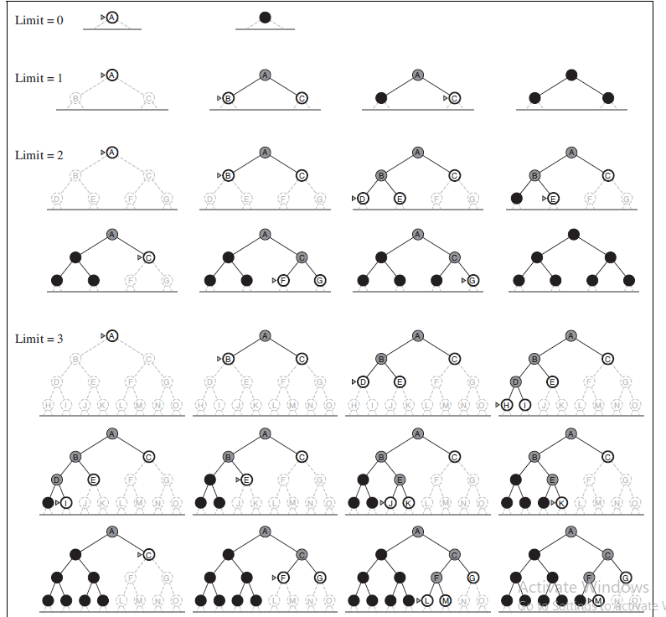

Iterative deepening depth-first search
Is it wasteful? because states are generated multiple times
No, this is not too costly.
In a search tree with the same / nearly the same branching factor at each level, most of the nodes are in the bottom level
Upper levels are generated multiple times
Nodes on bottom level (depth d) are generated once
Total number of nodes generated in the worst case is
Time complexity = O(b^{d}) (same as BFS)
Iterative deepening is
the preferred uninformed search method when the search space is large and the depth of the
solution is not known

Slide 53
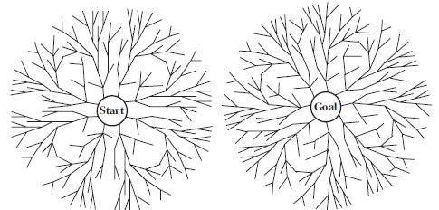
Bidirectional Search
Bidirectional search
runs two simultaneous searches
one forward from the initial state and
the other backward from the goal
hoping that the two searches meet in the middle
Implemented by replacing goal test with a check
Do frontiers of the two searches intersect?
if they do, a solution has been found
How do we search backwards?
Not very easy
requires a method for computing predecessor states
Possible For 8 piece and travel to reach destination
For several goal states (such as vacuum world)
A single state can be added as a successor for all goal states
For No queen attacks other queen
Searching from goal is impossible
A bidirectional search which is about to succeed

Slide 54
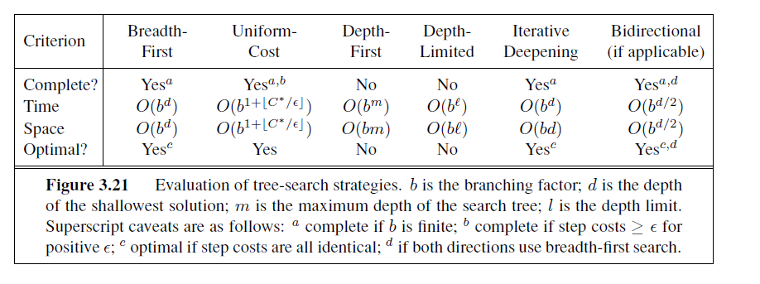
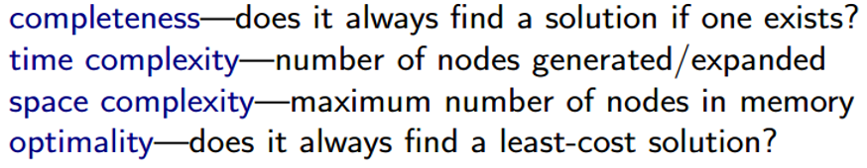
Comparing uninformed search strategies

Slide 55
Informed Search Strategy
Uses problem-specific knowledge beyond the definition of the problem itself
Can find solutions more efficiently than an uninformed strategy
General approach of Informed Search Strategy is called best-first search
Informed Search = Heuristic Search
Most best-first algorithms include a heuristic function
A heuristic function (aka heuristic) is a function
Ranks alternatives in search algorithms at each branching step
Based on available information to decide which branch to follow
For example, it may approximate the exact solution
A function to calculate an approximate cost to a problem to rank alternatives
Admissibility of a heuristic function = the characteristic that the heuristic function never overestimates the true cost

Slide 56
Best First Search
Recall that Uniform Cost Search expanded node n with the lowest path cost g(n)
UCS did this by storing the frontier as a priority queue ordered by g
Best First Search
A node is selected for expansion based on an evaluation function, f(n)
The evaluation function is construed as a cost estimate
the node with the lowest evaluation is expanded first
Best-first includes as a component of f, a heuristic function h(n):
h(n) = estimated cost of cheapest path from the state at node n to a goal state
h(n) takes a node as input
unlike g(n), it depends only on the state at that node
For now, consider h as arbitrary, nonnegative, problem-specific function
Only one constraint: if n is a goal node, then h(n)=0

Slide 57
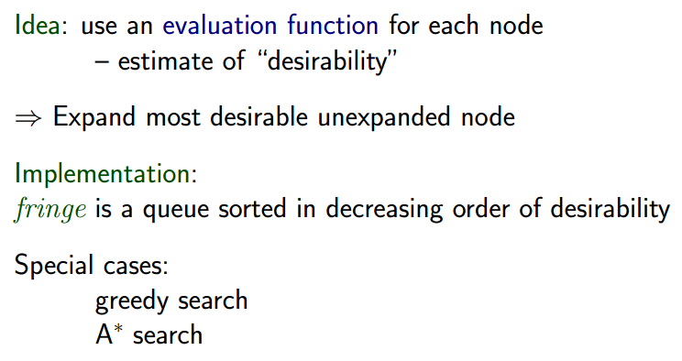
Best-First Search – Contd.

Slide 58
Greedy Search / Greedy Best First Search
Valuation function h(n)(heuristic) = estimate of cost from n to the closest goal
So in GBFS, f(n) = g(n)
Greedy search expands the node that appears to be closest to goal
Uses Straight Line Distance Heuristic, h_{SLD}
Constraints
1. Values of hSLD cannot be computed from the problem description itself
2. Domain expertise is needed to correlate h(n) values with actual road distances

Slide 59
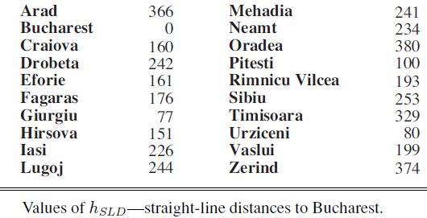
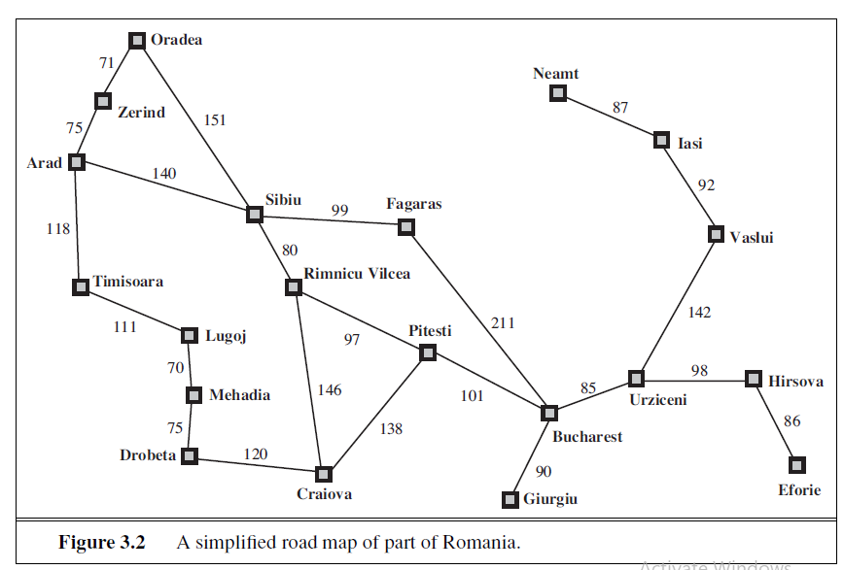

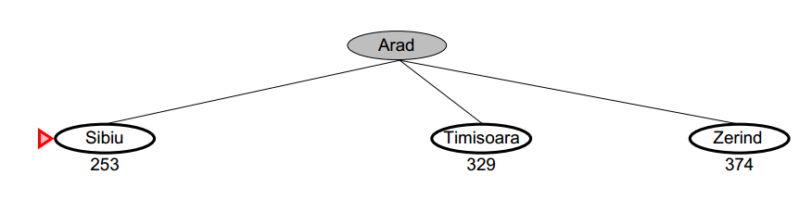
Greedy BF search – Example
Actual distances between cities are given in roadmap
Straight line distances between cities are in table

Slide 60
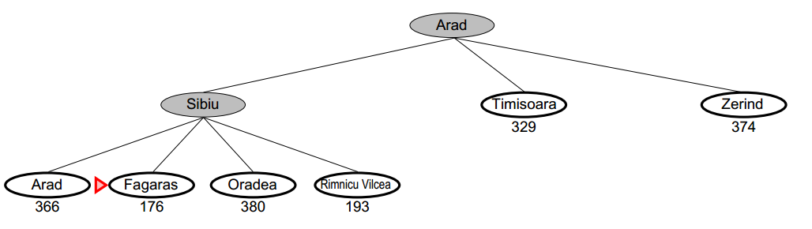
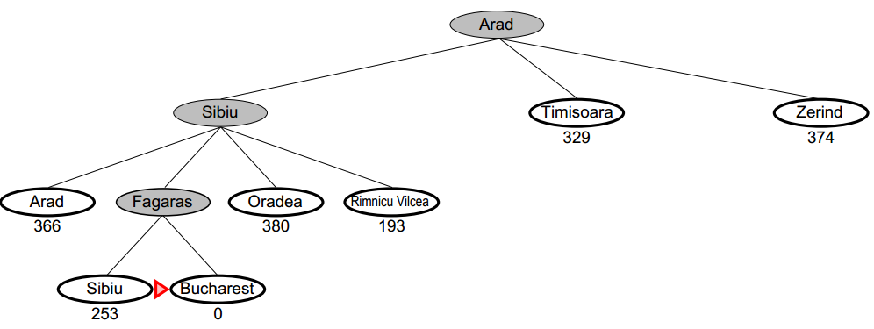
Greedy search – contd.

Slide 61
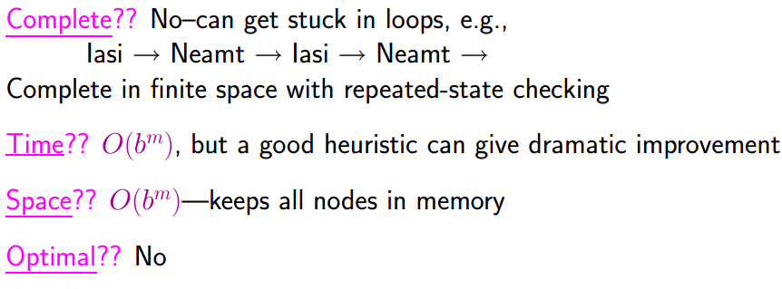
Properties of Greedy Search

Slide 62
A* algorithm (A-star algorithm)
Most widely known form of best-first search
Evaluates nodes by combining
g(n), path cost from the start node to node n, and
h(n), the estimated cost of cheapest path from n to the goal
f(n) = g(n) + h(n)
f(n) = estimated cost of the cheapest solution through n
Idea = Avoid expanding nodes which are already expensive
Identical to Uniform Cost Search
except that A∗ uses g + h instead of just g
A* strategy is more than just reasonable
Provided that the heuristic function h(n) satisfies certain conditions, A∗ search is both complete and optimal

Slide 63
Admissible Heuristic
First condition required for optimality is that h(n) be an admissible heuristic
never overestimates the cost to reach the goal
Remember h(n) = 0 when n is the goal state
i.e. h(n) ≥ 0, such that at any goal state node G, h(G) = 0, otherwise h(n) > 0
and f(n)=g(n) + h(n), [g(n) = actual cost to reach n along the current path]
Then at G, f(n) = g(n) + 0 = g(n) [actual distance]
The above have an immediate consequence that f(n) never overestimates the true cost of a solution along the current path through n
h(n) ≤ h*(n) where h*(n) is the true cost of n to goal
Example: h_{SLD}(n) never overestimates the actual road distance
So A* using h_{SLD} is optimal

Slide 64
Admissible Heuristic
The tree-search version of A* is optimal if h(n) is admissible
The graph-search version of A* is optimal if h(n) is consistent
Consistency (Monotonicity)
A heuristic h(n) is consistent
if, for every node n and every successor n’ of n generated by any action a,
the estimated cost of reaching the goal from n is no greater than (a) the step cost of getting to n’ + (b) the estimated cost of reaching goal from n’
Consistency/Monotonicity is a form of the general triangle inequality,
Each side of a triangle cannot be longer than sum of other two sides
Here, the triangle is formed by n, n’ and the goal G_{n} closest to n
For an admissible heuristic, the inequality makes perfect sense:
if there were a route from n to Gn via n’ that was cheaper than h(n), that would violate the property that h(n) is a lower bound on the cost to reach G_{n}.

Slide 65
A* - Roadmap example
Actual distances between cities are given in roadmap
Straight line distances between cities are given in table

Slide 66

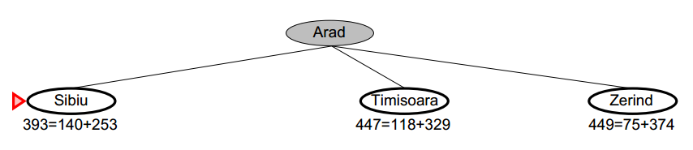

A* Example

Slide 67


A* Example – Contd.

Slide 68

A* Example – Contd.

Slide 69
A*-summary
Dijkstra’s algorithm is a special case of A*, when we set h(v) = 0 for all v
Path finding algorithms such as A* help in planning route (proactive) rather than lazy discovery of the problem (reactive)
Slower than UCS or BF-Greedy, with more computations
One of the most popular search algorithms in AI
Quality of results depends on quality of Heuristic used
Where used?
AI Games
Robotics / Machine Learning

Slide 70
AND/OR graphs
Some problems are best represented as achieving subgoals, some of which achieved simultaneously and independently (AND)
Up to now, we only dealt with OR options
Get Rich
AND
Become a crooked politician
Establish a business for manufacturing a great product
Increase sales of the product across the globe

Slide 71

Searching AND/OR graphs
A solution for an AND–OR search problem is a subtree that
has a goal node at every leaf,
specifies one action at each of its OR nodes, and
includes every outcome branch at each of its AND nodes
Cost function: sum of costs in AND node
f(n) = f(n₁) + f(n₂) + …. + f(n_{k})
How can we extend A* to search AND/OR trees?
The AO* algorithm

Slide 72
AND/OR search
We must examine several nodes simultaneously when choosing the next move
A
A
(9)
D
(3)
B
(5)
C
(4)
38
B
C
D
17
9
27
E
F
G
H
I
J
(5)
(10)
(3)
(4)
(15)
(10)

Slide 73
AO* algorithm
Let G be a graph with only starting node INIT
Repeat the followings until INIT is labeled SOLVED or h(INIT) > FUTILITY
Select an unexpanded node from the most promising path from INIT (call it NODE)
Generate successors of NODE. If there are none, set h(NODE) = FUTILITY (i.e., NODE is unsolvable); otherwise for each SUCCESSOR that is not an ancestor of NODE do the following:
Add SUCCESSSOR to G.
If SUCCESSOR is a terminal node, label it SOLVED and set h(SUCCESSOR) = 0.
If SUCCESSOR is not a terminal node, compute its h

Slide 74
AO* algorithm (Cont.)
Propagate the newly discovered information up the graph by doing the following: let S be set of SOLVED nodes or nodes whose h values have been changed and need to have values propagated back to their parents. Initialize S to Node. Until S is empty repeat the followings:
Remove a node from S and call it CURRENT.
Compute the cost of each of the arcs emerging from CURRENT. Assign minimum cost of its successors as its h.
Mark the best path out of CURRENT by marking the arc that had the minimum cost in step ii
Mark CURRENT as SOLVED if all of the nodes connected to it through new labeled arc have been labeled SOLVED
If CURRENT has been labeled SOLVED or its cost was just changed, propagate its new cost back up through the graph. So add all of the ancestors of CURRENT to S.

Slide 75

An Example

Slide 76

An Example
(8)
A

Slide 77

An Example
Only heuristic costs are visible. So taking the path towards B.
By moving to B the actual cost is realized (8 + 4 =12)
Then since there is an AND all paths beneath C and B should be completed.

Slide 78

An Example
Then since there is an AND all paths beneath C and B should be completed.
All heuristic values are updated with actuals, if explored
So from A to C, value is now 8+4+2 =14 through B
The heuristic from C to E adds 1 (So 14+1 = 15 for A-B-C-E)
Directly from A to C, cost is 5. So total (since AND) = 14+5 = 19
So explore towards D with heuristic cost 8

Slide 79
An Example
Exploring D with heuristic cost 8, actual cost becomes
8+5 =13
From D, either E or F are possible (F is also Goal State G), with heuristic 0
So that path is taken (8 + 5 + 4) = 17
[15]
A
[8]
4
5
5
(4)
B
D
(3)
2
C
2
(2)
4
E
(1)
G
(0)

Slide 80
An Example
Exploring D further through E with heuristic 1,
8+5+2 =15
Finally from E to G, path is taken (8 + 5 + 2 +3) =18
[15]
A
[9]
4
5
5
(4)
B
D
(4)
2
C
2
(2)
2
4
E
(3)
3
G
(0)

Slide 81
An Example
Final cost is 8 + 5 + 4 = 17
[15]
A
Solved
4
5
Exploring C is not necessary as by moving from C to E the cost is not going to be better (A-C is costlier than A-D)
5
(4)
B
D
Solved
2
C
2
(2)
2
4
E
(3)
3
G
Solved
(0)

Slide 82
Summary
Agent
Agent function
Agent program
Rational agent
Task environment
Performance measure, Environment, Actuators, Sensors (PEAS)
Types of agents
TDA, Simplex reflex, model-based, goal-based, utility based, learning agent

Slide 83
References
AIMA
Artificial Intelligence - A Modern Approach 3rd Edition - RUSSELL & NORVIG

